Slide 1
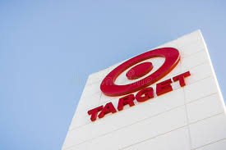
Photo:
https://encrypted-tbn0.gstatic.com/images?q=tbn:ANd9GcSsirAmBNMz6eXnzK1-jrnK7KTGoHoAHPgjpw&usqp=CAU
Notes:
https://encrypted-tbn0.gstatic.com/images?q=tbn:ANd9GcSsirAmBNMz6eXnzK1-jrnK7KTGoHoAHPgjpw&usqp=CAU

Slide 2

Mission as stated on Target’s corporate website:
To help all families discover the joy of everyday life.
Tag Line:
Expect more. Pay less. - Since 1994
Eat well. Pay less. - Added in 2004
Mission as stated on other sites online:
To make Target the preferred shopping destination for our guests by delivering outstanding value, continuous innovation and exceptional guest experience by consistently fulfilling our “Expect More. Pay Less.” Brand promise.

Slide 3
Current Vision:
Guided commitments to great value, the community, diversity and the environment
They are living this out through prioritizing their branded statement “Expect more Pay less”, through financial give back programs and other initiatives.

Slide 4
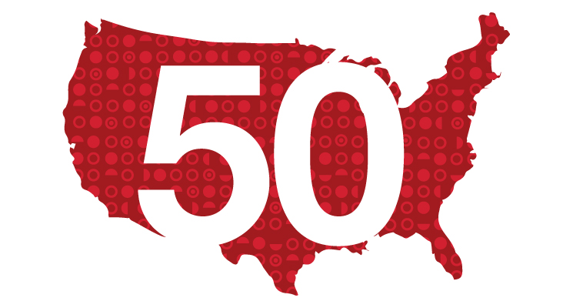
Target’s Operating Procedures
Operates in all 50 states
1886 stores as of 2019
75 % residents have Target within easy reach
41 distribution centers to support the operation of 1868 Target stores

Slide 5
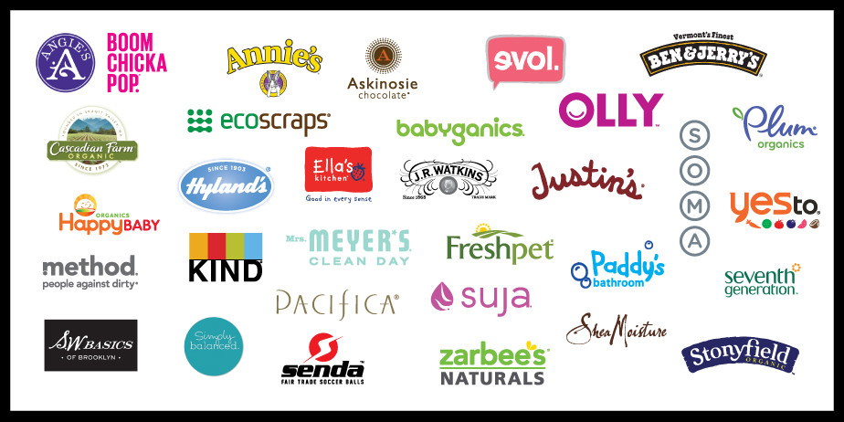
Target’s Operating Procedures
41 private Brands
Supplier from all over the world but brands made by company
Partners with designers and brands from time to time to launch an exclusive range for customers

Slide 6
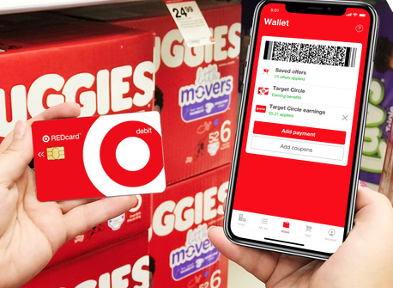
Product quality and pricing
Operating expenses
Costs of sales
General, and administrative expenses
Keeps operating cost low
Safety is first
Trains employees for good service
Discount prices
Focuses on customer experience and satisfaction
Branded debit and credit cards called RED card
In-app coupons and 1% earning

Slide 7
Merchandise
Food & beverages
Apparel & accessories for men, women and kinds
Baby
Household essentials
Home decor
Furniture
Patio & garden
Kitchen & dining
Toys
Electronics
Musical instruments
Movies, music, video games & books
Sports & outdoors
Beauty
Personal care
Pets
Luggage
School & office supplies
Party supplies

Slide 8
Investment Strategy
Remodeled more than 700 stores
Grew its store networks
Redesigned store operating model and redefined the roles for hundreds and thousands of team members
Invests in its people and increases starting wages up to $ 15 per hour
Launched its Good and Gather food and beverages brand
Makes e-commerce more attractive and profitable

Slide 9
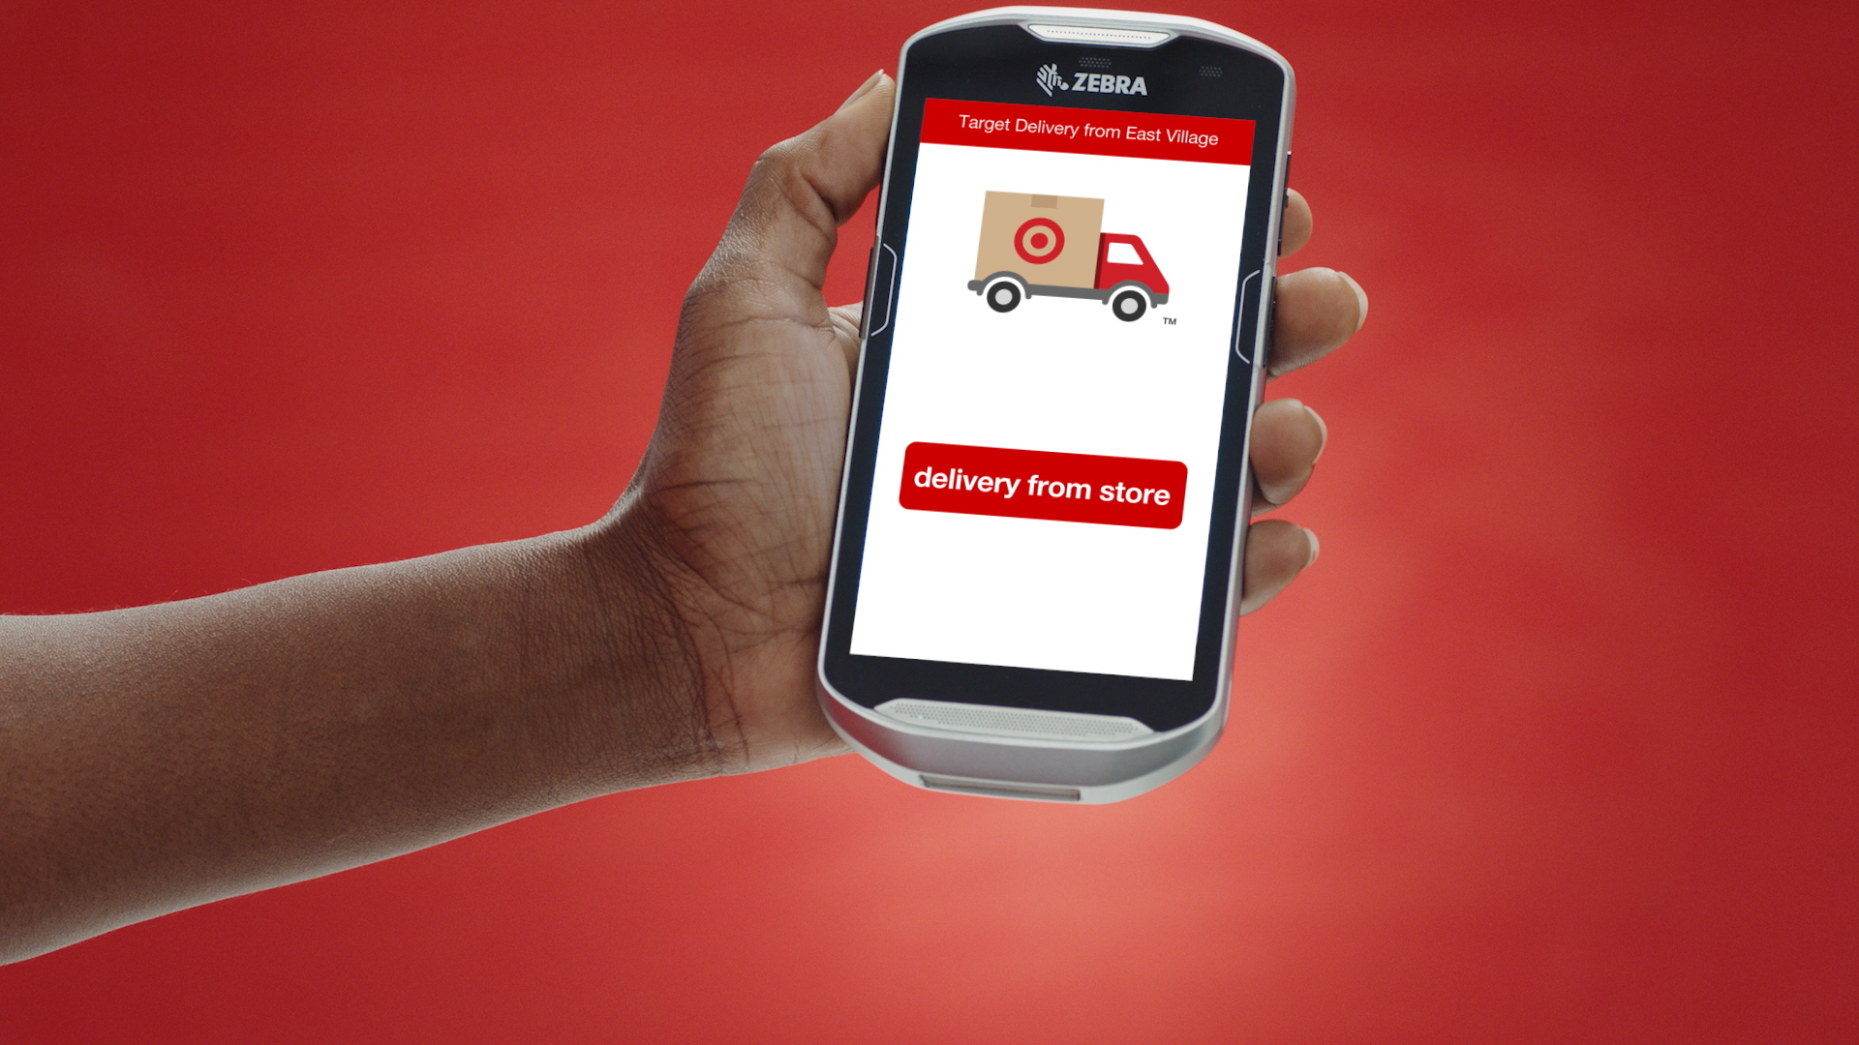
Marketing
Speed
Barcodes and product scanning
Free shipping & Fast delivery
Invested around $ 1.65 billion in advertising in 2019
Utilizes both digital and traditional channels for promotions

Slide 10

Supply Chain Management

Slide 11
Order-to-shelf
Vacant shelf
Order product
Consumer
Target stores wait until items have sold, and based on these figures complete their orders for more product. There is no inventory or back of house warehouse.

Slide 12
E-commerce
Supplier
Store
Consumer
Target sources all e-commerce orders from their stores’ inventory, utilizing a “one inventory philosophy”. Target has no inventory that is not customer-facing.
Notes:
The “unified strategy” brings all markets (ecommerce, in person shopping experience) into targets market, bringing more revenue to cover all of their physical assets.

Slide 13
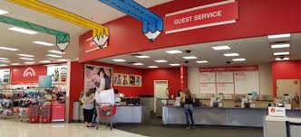
Target’s supply chain overview
Global supply chain
Brands
Ethics
E-Commerce
Notes:
Global Supply chain
Order to shelf & 1 inventory philosophy
Ethics: high standards for disclosure from all textile suppliers
Target Brands make the supply chain shorter, no extra steps
Ecommerce: target owns their delivery service, grand junction

Slide 14
Value Chain
Create value in products made and sold
Outbound logistics
Partnerships with Target
Pick-and-Pack Strategy
Moving from store to experience

Slide 15
Product and Service Design
Loyalty Member Promotions
“Design for All” Strategy
Expect more, pay less
3D and AI usage
Competing with big brand names

Slide 16

Quality Management, Assurance, & Control

Slide 17

The Best Products Everytime You Shop
Safety is the Top Priority
Target Brand & General Merchandise Target Tested and Third Party Tested
Target Specific Standards and Regulations
Vendors must comply and document thoroughly
No Product is Shipped unless it has passed all tests
Easy access to Recall information and Product list

Slide 18
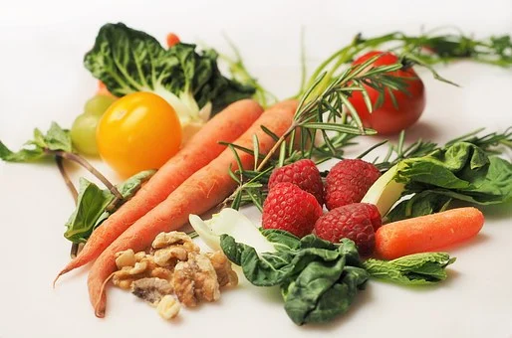
Food Product Safety
Consistently monitors safety and quality of food products
Asses vendor individually
Must pass Target Specific regulations
Evaluate at vendor’s facility, in supply chain, & at stores
Regulatory Compliance & Labeling
Extra oversight for allergens and pathogens

Slide 19
Recommendations in Quality Management & Control
Review and analyze data on recalled Items to ensure the safety of future like or similar products

Slide 20
Total Quality Management

Slide 21
What is Total Quality Management?
Management approach
Long-term success
Customer satisfaction
All members of an organization participate in improving processes, products, services, and the culture in which they work
Notes:
Total Quality management describes a management approach to long-term success through customer satisfaction. In a TQM effort, all members of an organization participate in improving processes, products, services, and the culture in which they work.

Slide 22
Customer Focus
Servicing wants and needs through high quality merchandise
Ease and convenience shopping experience
Clean atmosphere and fun-to-shop ambience
Knowledgeable and Helpful employees
Speedy Checkout
Target RedCard
Target Circle
Deliver, Ship, or pick-up
Notes:
Total Quality Management has 8 primary elements: Customer-focused, Total employee involvement, Process-centered, Integrated system,Strategic and Systematic approach, continual improvement, fact-based decision making, and effective communications.
Customer-focused: The customer ultimately determines the level of quality. No matter what an organization does to foster quality improvement—training employees, integrating quality into the design process, or upgrading computers or software—the customer determines whether the efforts were worthwhile.
Total employee involvement: All employees participate in working toward common goals. Total employee commitment can only be obtained after fear has been driven from the workplace, when empowerment has occurred, and when management has provided the proper environment. High-performance work systems integrate continuous improvement efforts with normal business operations. Self-managed work teams are one form of empowerment.
Process-centered: A fundamental part of TQM is a focus on process thinking. A process is a series of steps that take inputs from suppliers (internal or external) and transforms them into outputs that are delivered to customers (internal or external). The steps required to carry out the process are defined, and performance measures are continuously monitored in order to detect unexpected variation.
Integrated system: Although an organization may consist of many different functional specialties often organized into vertically structured departments, it is the horizontal processes interconnecting these functions that are the focus of TQM.
Micro-processes add up to larger processes, and all processes aggregate into the business processes required for defining and implementing strategy. Everyone must understand the vision, mission, and guiding principles as well as the quality policies, objectives, and critical processes of the organization. Business performance must be monitored and communicated continuously.
An integrated business system may be modeled after the Baldrige Award criteria and/or incorporate the ISO 9000 standards. Every organization has a unique work culture, and it is virtually impossible to achieve excellence in its products and services unless a good quality culture has been fostered. Thus, an integrated system connects business improvement elements in an attempt to continually improve and exceed the expectations of customers, employees, and other stakeholders.
Strategic and systematic approach: A critical part of the management of quality is the strategic and systematic approach to achieving an organization’s vision, mission, and goals. This process, called strategic planning or strategic management, includes the formulation of a strategic plan that integrates quality as a core component.
Continual improvement: A large aspect of TQM is continual process improvement. Continual improvement drives an organization to be both analytical and creative in finding ways to become more competitive and more effective at meeting stakeholder expectations.
Fact-based decision making: In order to know how well an organization is performing, data on performance measures are necessary. TQM requires that an organization continually collect and analyze data in order to improve decision making accuracy, achieve consensus, and allow prediction based on past history.
Communications: During times of organizational change, as well as part of day-to-day operation, effective communications plays a large part in maintaining morale and in motivating employees at all levels. Communications involve strategies, method, and timeliness.

Slide 23
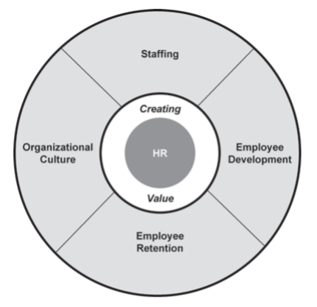
Total Employee Involvement
Employees are the keepers of the “Expect More. Pay Less.” brand in all services
Fast, fun, and friendly culture
Hire quality over quantity creating a sustaining workforce
Fill open positions quickly
Hire ahead of needs
Employee feedback surveys, sessions, and forums

Slide 24
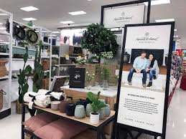


Process-Centered & Strategic/Systematic approach
Constant hands-on effort by Target Sourcing Services teams working with suppliers
Sourcing goods for needs and wants of customers
Only-at-Target items and brands
Strategic Planning:
2021: redesigned electronics center with tech consultants and store fronts to be more welcoming
2020 - expanding order-pickup and same-day services
introduce/test Robotic solutions to sorting and restocking
Remodeling stores for convenience and clean look
2019: small store formats introduced
Same-day services and order-pickup created

Slide 25
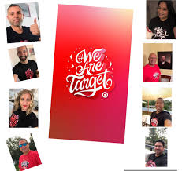
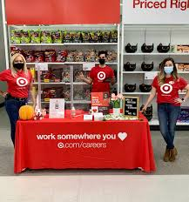
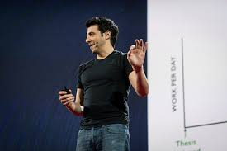
Communication
Daily Newsletter (2016)
Town Hall Meetings
RED Talks
Product Stories
Events & Experiences for Employees
Social Media for Employees
In-ear radio communication

Slide 26
Questions?

Slide 27
References
ASQ. (n.d.). What is total quality MANAGEMENT (TQM)? Retrieved February 07, 2021, from
https://asq.org/quality-resources/total-quality-management
Ramlall, S. (2006, February 09). Strategic HR management creates value at Target. Retrieved February 08, 2021,
from https://onlinelibrary.wiley.com/doi/pdf/10.1002/joe.20090
Target. (n.d.). purpose & history | Target Corporation. Target Corporate. Retrieved February 7, 2020, from https://corporate.target.com/about/purpose-history
M. (2019, July 15). Target Mission and Vision Statement Analysis. Mission Statement Academy. https://mission-statement.com/target/
Pratap, Abhijeet. (2020, June 27). Business Model of Target Corporation. Retrieved from https://notesmatic.com

Slide 28
References Continued
Target. (2020, November 10). Products & SERVICES: Target Corporation. Retrieved February 09, 2021, from
https://corporate.target.com/about/products-services#:~:text=We're%20proud%20to%20offer,a%20breeze%E2%80%94no%20members
ip%20required.&text=Target%20offers%20a%20store%20card,thousands%20of%20items%2C%20every%20day.
Target Corporation. (2021). A bullseye View. behind the scenes at Target. Retrieved February 09, 2021, from
https://corporate.target.com/corporate-responsibility/civic-activity/public-policy
Target Corporation. (2020, March). A bullseye View. behind the scenes at Target. Retrieved February 09, 2021, from
https://corporate.target.com/press/releases/2020/03/target-outlines-2020-strategic-initiatives
Bradley, D. (2017, August 22). How a series of Crises FLIPPED TARGET'S internal comms strategy on its head. Retrieved February 09, 2021, from
https://www.prweek.com/article/1410966/series-crises-flipped-targets-internal-comms-strategy-its-head#:~:text=Target's%20internal%20communications%20strategy%20goes,our%20team%2C%22%20Jenkins%20said.

Slide 29
References Continued
Target Corporation. (2021). Brands: Target Corporation. Retrieved February 09, 2021, from
https://corporate.target.com/about/products-services/Target-Brands

